Slide 1
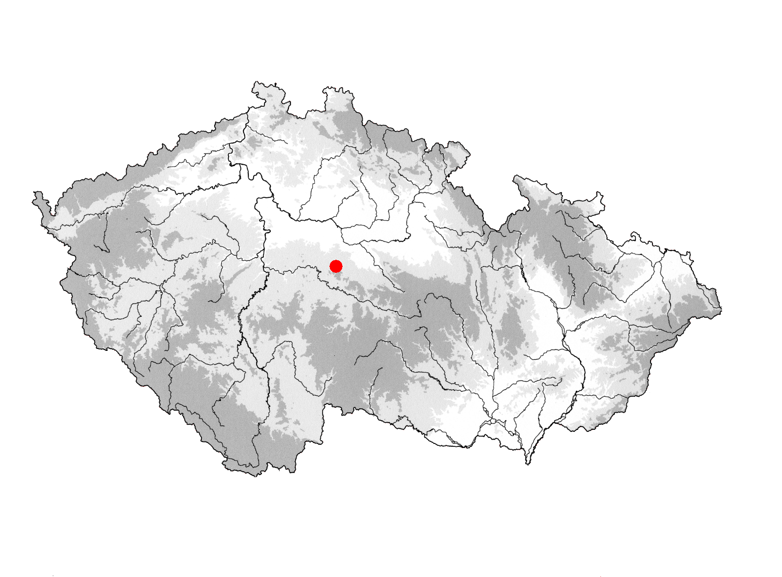

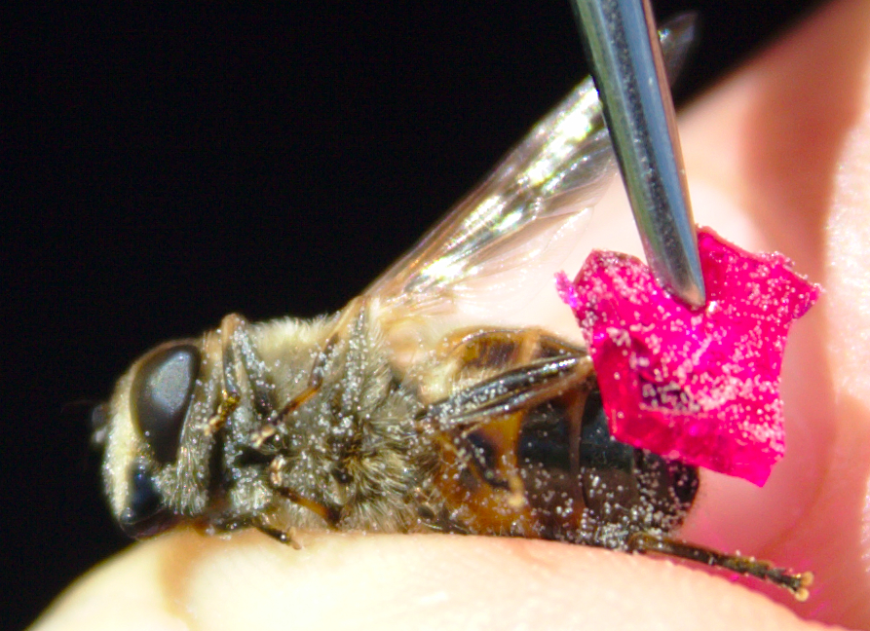
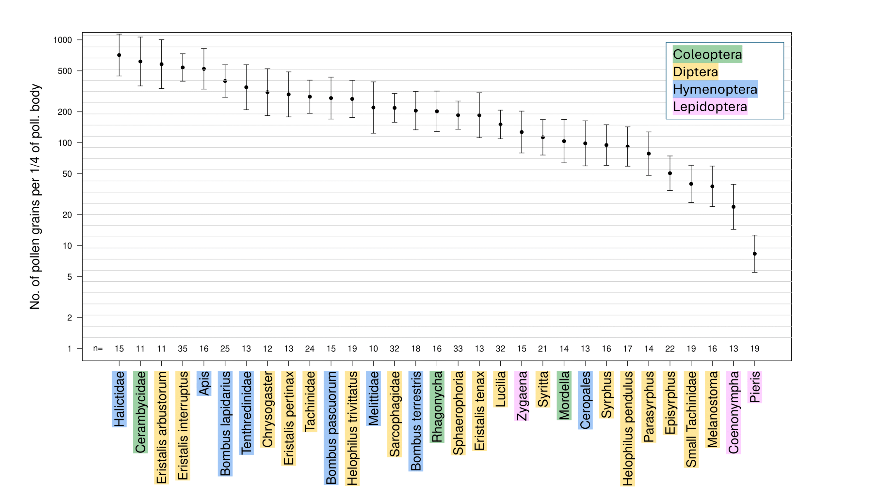
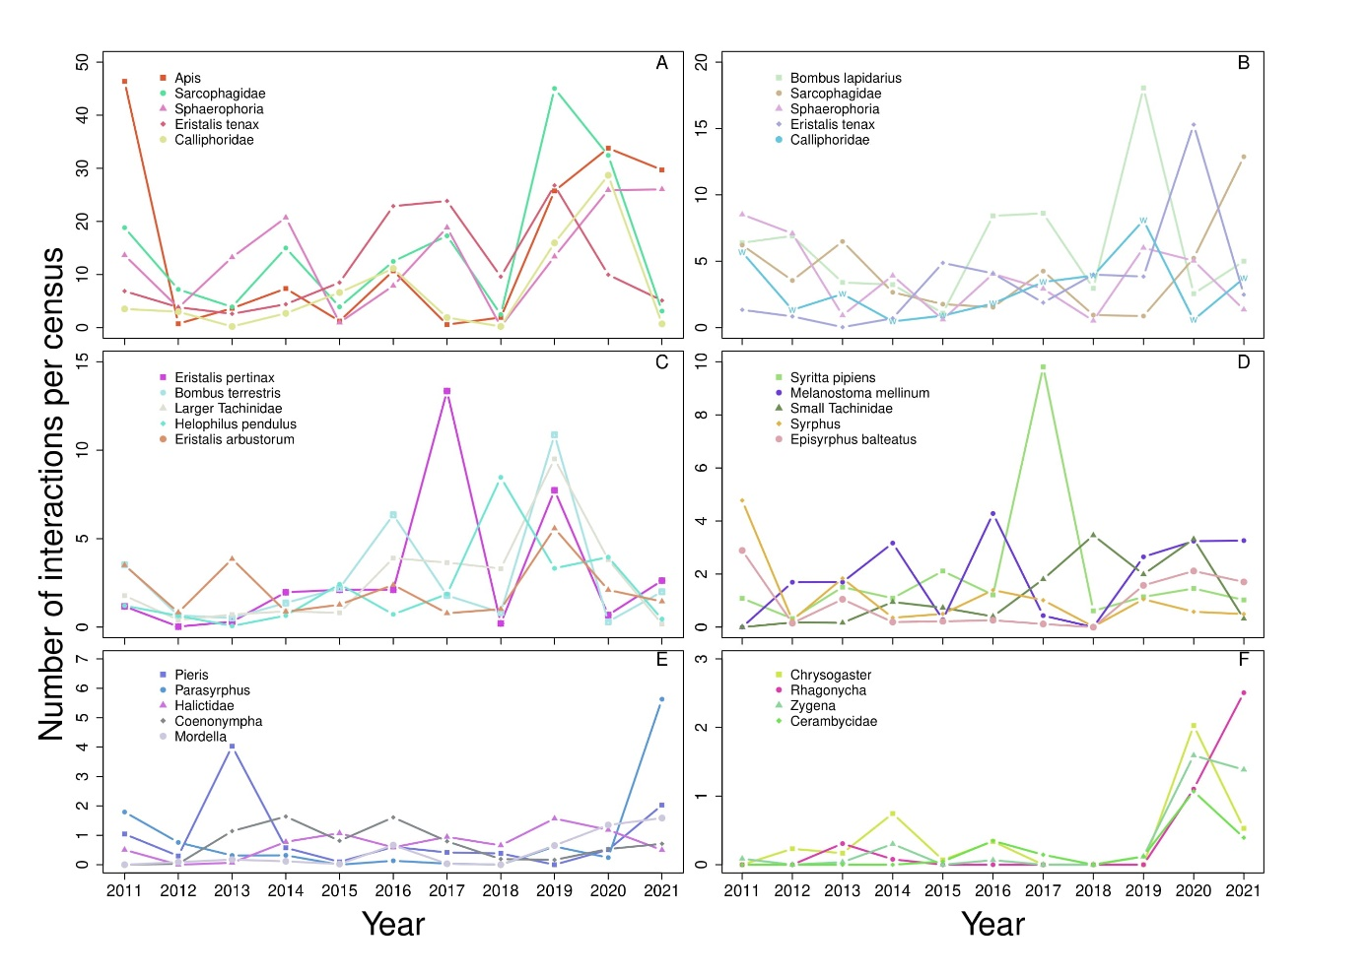
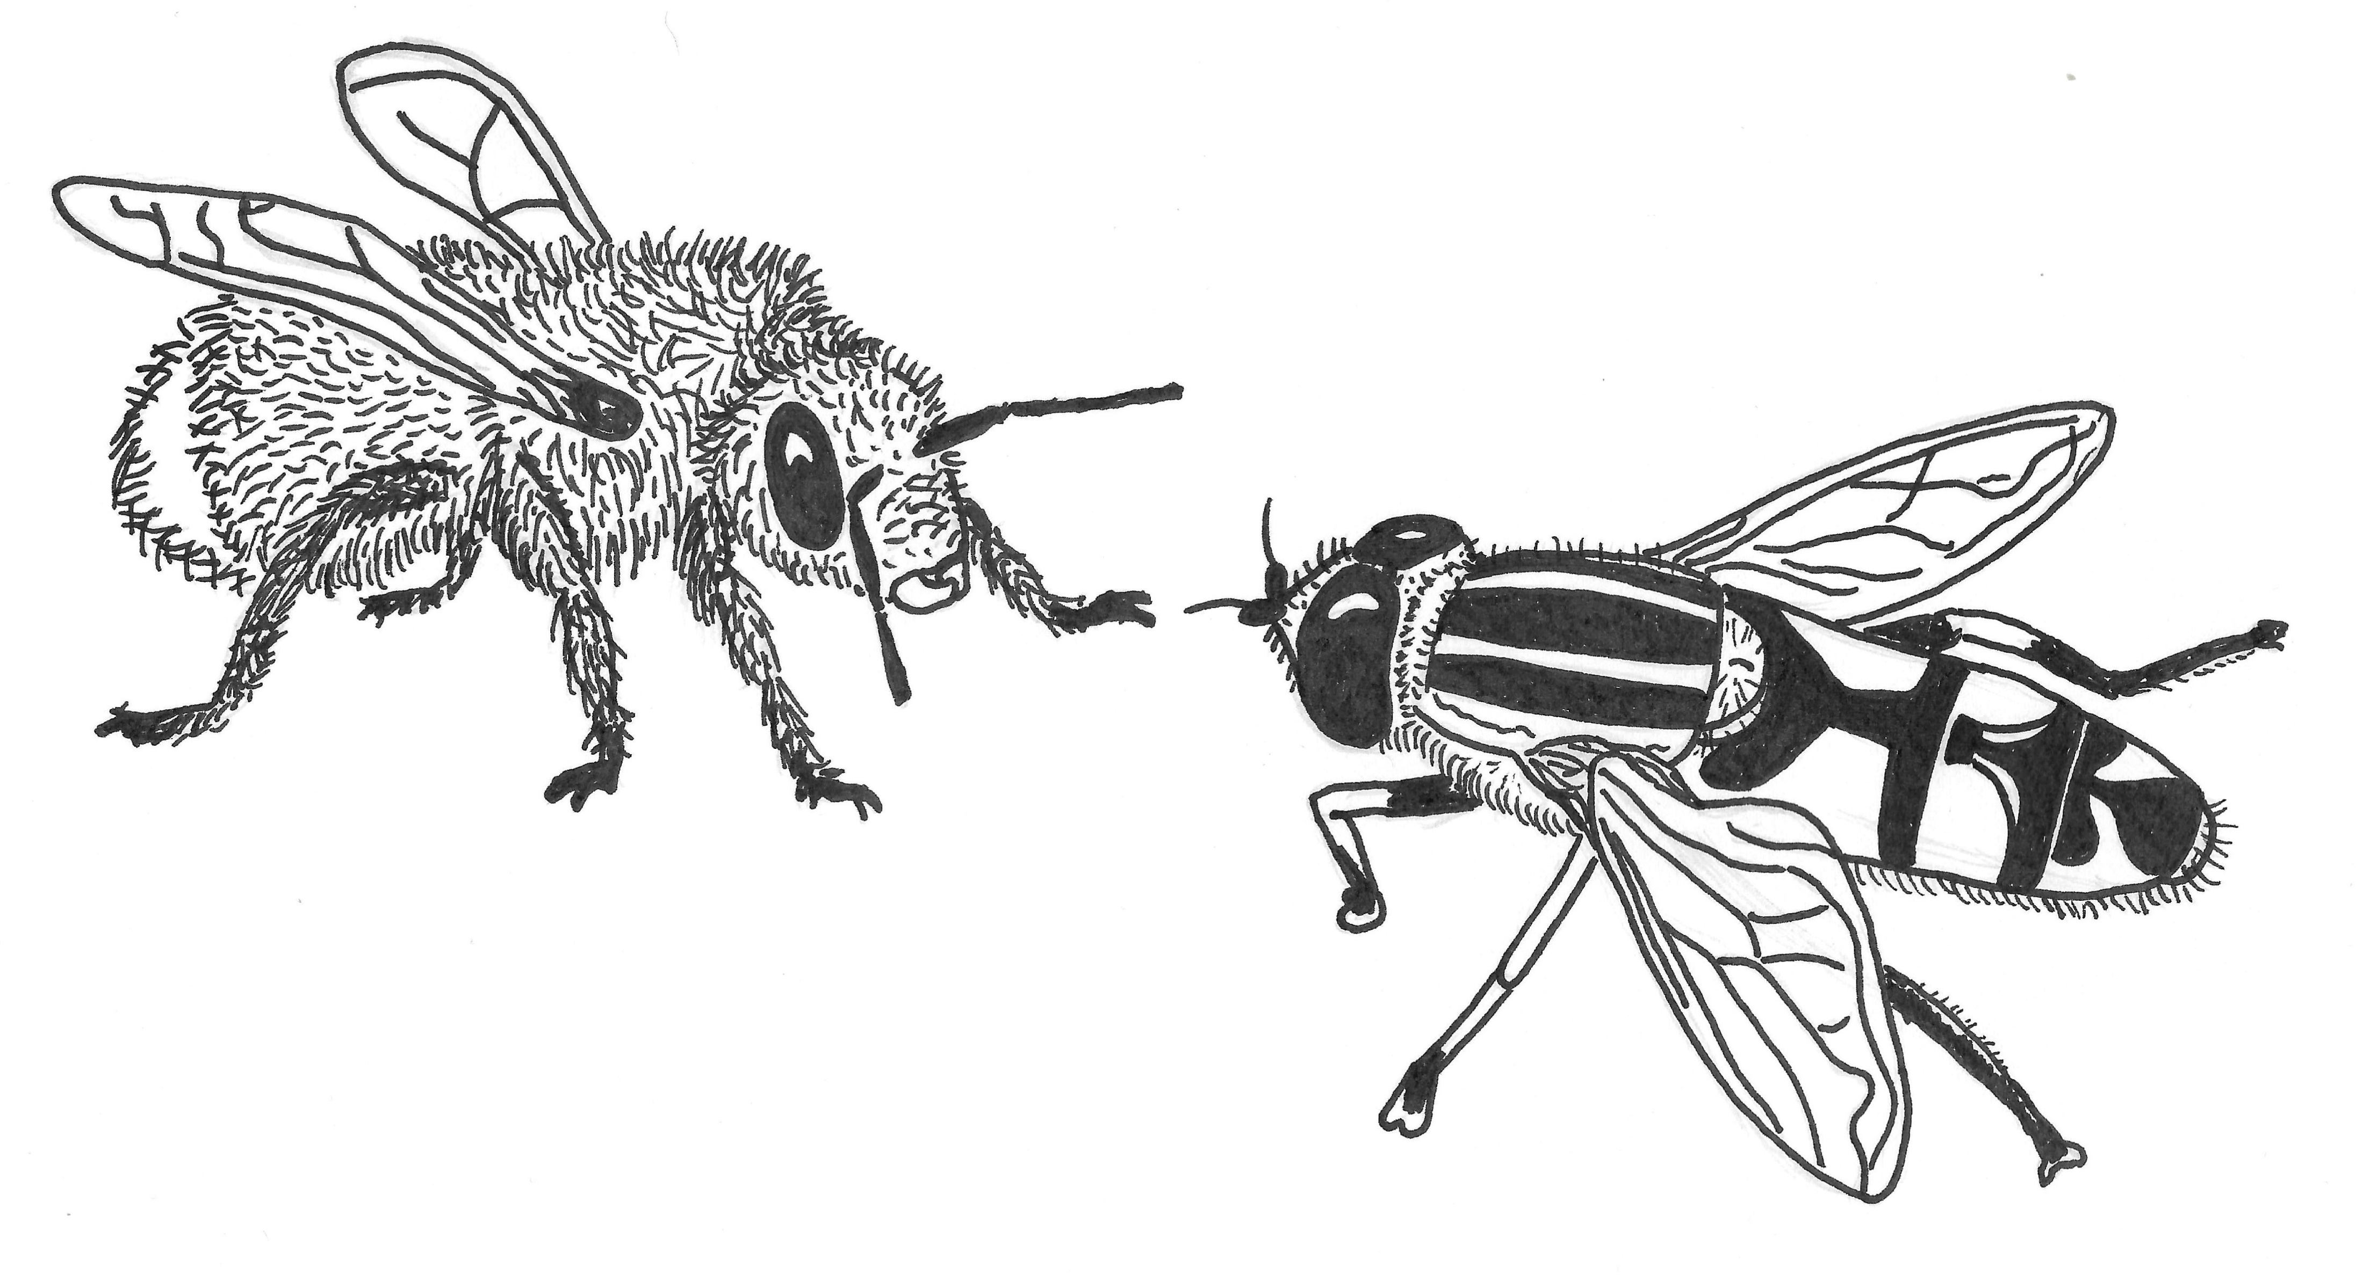



INTERANNUAL DIFFERENCE IN POLLINATOR CONTRIBUTION TO POLLEN TRANSFER
31 pollinator taxa
11 years of abundance data-collecting
Martin Freudenfeld*, J. Štenc, J. Hadrava, M. Mikát, E. Matoušková, K. Daňková, T. Jor, T. Ryšan, K. Koupilová, J. Simon-Pražák, T. Dvořák, Z. Janovský
*Department of Botany, Charles University, Prague, CZ
HOW DO POLLINATORS CONTRIBUTE TO POLLEN TRANSFER?
Do the contribution to pollen transfer vary due to ability to carry pollen or due to variation in visitation density?
Prague
K Handrkovu meadow
POLLEN LOAD
Pollen collecting:
Half of pollinator´s body
Small block of fuchsine jelly
Pollen grains counted with microscope
Pollen in scopa not sampled
Visitation density:
93 permanent plots over the meadow
Plant and pollinator density every season since 2011
Insects touching plant´s reproductive organs for 2 seconds
VISITATION DENSITY
POLLINATOR CONTRIBUTION TO POLLEN TRANSFER DEPEND ON THE VISITATION DENSITY
No big variation in pollen load among pollinators
Very big differences in pollinator densities over the years
Each pollinator taxa is important and necessary
Contact: freudenm@natur.cuni.cz
My special thanks to all members of the Pollination Ecology Group in Prague and all the people involved in the „Opylovači“ project who selflessly participated in more than a decade of fieldwork.

